Slide 1
HMIS Advisory
Committee Meeting
Central Florida Commission on Homelessness (CFCH)
CoC FL-507
Sept 10th, 2024
Brad Sefter, Committee Chair
Notes:
Call to order: Brad -All in attendance verify name, add agency
Next slide: Brad (agenda)

Slide 2
HMIS Advisory Committee Mission
HMIS Advisory Committee Purpose
Our mission is to effectively use data, which includes inputs from those in need of services, those providing services, and from members of the community, to eliminate homelessness in Central Florida.
Oversee the CoC’s implementation of HMIS, what we do with the data and how we use it.
Notes:
Presenter: Brad
Next Slide: Brad

Slide 3
Agenda
Welcome
Call to Order
Committee Roll Call
Approval - Minutes from July 9th, 2024
Voice Vote - Agenda for Sept 10th, 2024
HMIS Team Reports:
Voting Member Confirmations
Officer Position Nominations and Committee Vote
Deceased Client Workflow – Moved to November
Review Client Access Rights to Data
Top 3 Data Quality Issues
Review HSN Enrollment Summary Dashboard
Christian Service Center Breakfast Gala – Oct 11th
HMIS Agency Liaison Partner Event
Release of Information Reminders
COMMITTEE VOTE - All motions before committee
Notes:
Presenter: Brad -Agenda Roll Call Vote (meeting minutes from last meeting uploaded here: https://www.hmiscfl.org/hmis-advisory-committee-2/)
Next: Rocky

Slide 4
HMIS Team Reports
Voting Member Confirmations – Brittney Behr
Officer Position Nominations and Committee Vote – Brittney Behr
Review Client Access Rights to Data – Brittney Behr
Top 3 Data Quality Issues – Agustin Paz
Review HSN Enrollment Summary Dashboard – Ashley Brozenske
Christian Service Center Breakfast Gala – Oct 11th – Brittney Behr
Training Updates and Feedback – Racquel McGlashen
HMIS Agency Liaison Partner Event – Racquel McGlashen
Release of Information Reminders – Racquel McGlashen
Notes:
Presenter: Brad
Next Slide: Ashley

Slide 5
HMIS Advisory Committee Nominations
Chair | TBD
Vice Chair | TBD
Secretary/Recorder | TBD
Voting Member | Brad Sefter | Healthcare Center for the Homeless
Voting Member | Danielle Landaal | IDignity
Voting Member | Keisha Thomas | The Sharing Center
Voting Member | Melissa Sandel | Christian Service Center
Voting Member | Caren Olsen | Covenant House
Voting Member | Karen Jackson | Zebra Youth Coalition
Voting Member | Nancy Martinez | Samaritan Resource Center
HMIS Team Liaison | Brittney Behr | HSN - HMIS Project Coordinator
Notes:
Presenter: Brad -Committee Roll Call
Next Slide: Brad (Agenda Roll Call)

Slide 6
HMIS Advisory Officer Nominations
Chair | Nominee – Melissa Sandel
Vice Chair | Nominee – Brad Sefter
Secretary/Recorder | Nominee – Danielle Landaal
Advisory Committee Elections
Let's take a vote!
Notes:
Presenter: Brad -Committee Roll Call
Next Slide: Brad (Agenda Roll Call)

Slide 7
Deceased Client Workflow Changes

Slide 8
Review Client Access Rights
What is it?
We released a policy last year about a client's rights to access their data in HMIS. Clients have the right to review and request copies of their own data.
Why is it important?
We recently experienced someone trying to get a copy of a client's information. We want you to be informed of the procedures when providing a client with their own data.
Let's learn about the Client Access Rights Policy together through a quiz!
Join at www.kahoot.it (Please hold for PIN)

Slide 9
Top 3 Data Quality Issues in HMIS
NULL (or missing) Relationship to Head of Household
Prior Living Situation - Program Eligibility
Housing Move-In Date (HMID)
Knowledge Check

Slide 10
NULL (or missing) Relationship to Head of Household
Every member of a household enrollment MUST have a value for their Relationship to Head of Household
One member (and ONLY one) MUST be identified as the “Self” of a Household Enrollment.
For an individual enrollment, that person should always be the “Self” for Relationship to Head of Household.
Use Family Members to add other household members; however, it MUST also be selected as part of the Program Enrollment.

Slide 11
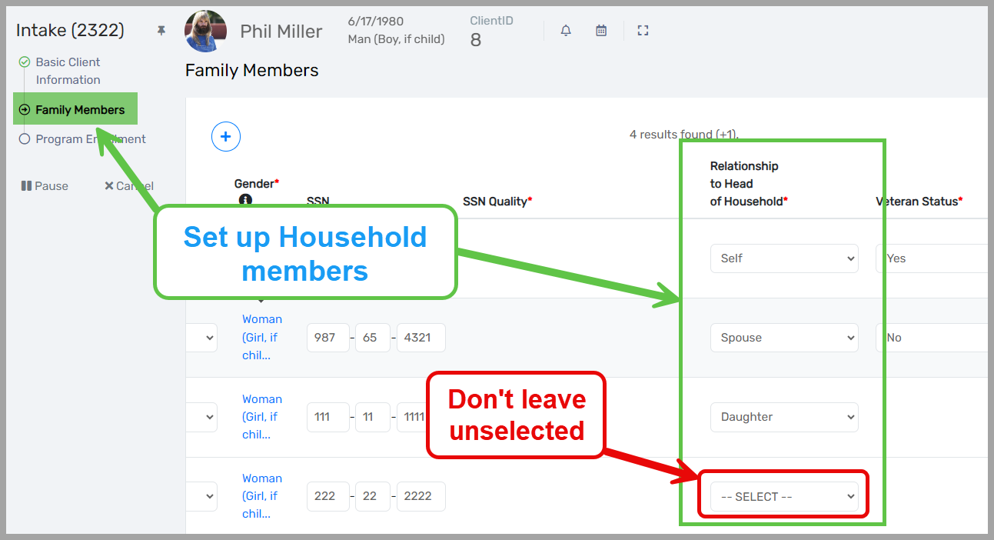
NULL (or missing) Relationship to Head of Household
Based on using Edit Project Entry Workflow

Slide 12
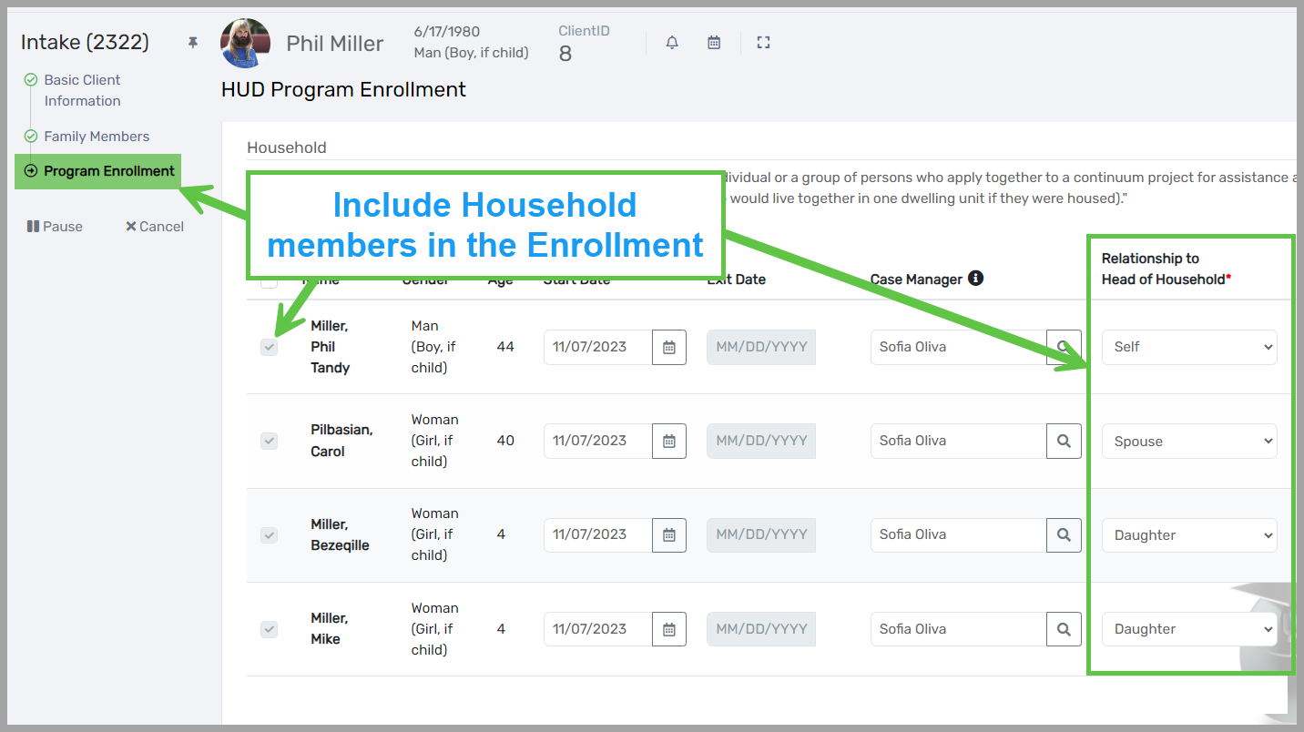
NULL (or missing) Relationship to Head of Household
Based on using Edit Project Entry Workflow

Slide 13
Prior Living Situation - Program Eligibility
The Prior Living Situation is a valuable field for all enrollments, indicating what the participant’s living situation is at the point of the enrollment start.
For Rapid Re-Housing (RRH) & Permanent Supportive Housing (PSH), the Prior Living Situation MUST evaluate to a Homeless Situation for eligibility purposes.
The easiest way to review PLS is with the APR/CAPER using the following questions:
Q6d – Data Quality: Chronic Homelessness
Q15 – Living Situation
For participants whose PLS DOESN'T evaluation to a Homeless Situation, then an explanation can be added in CT using “SAGE Explain Other Living Situation” found under “Other Assessment” for each client.

Slide 14
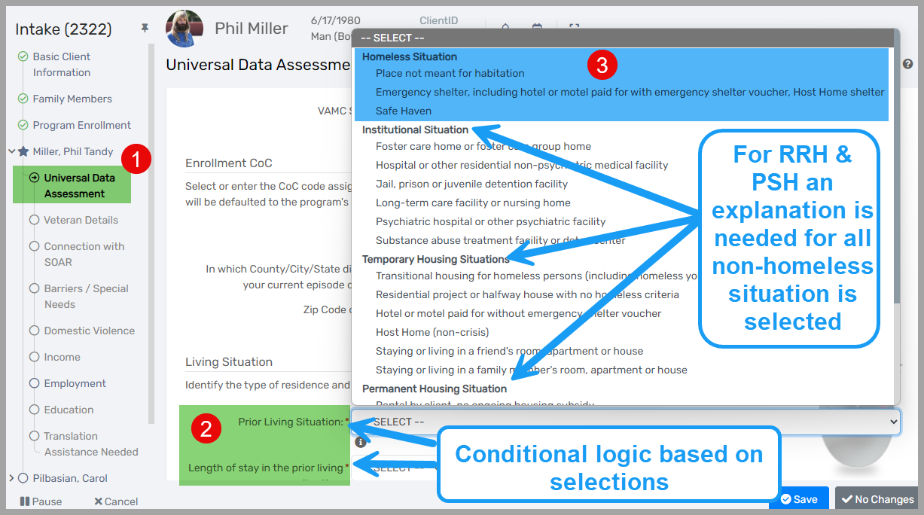
Prior Living Situation - Program Eligibility
Based on using Edit Project Entry Workflow

Slide 15
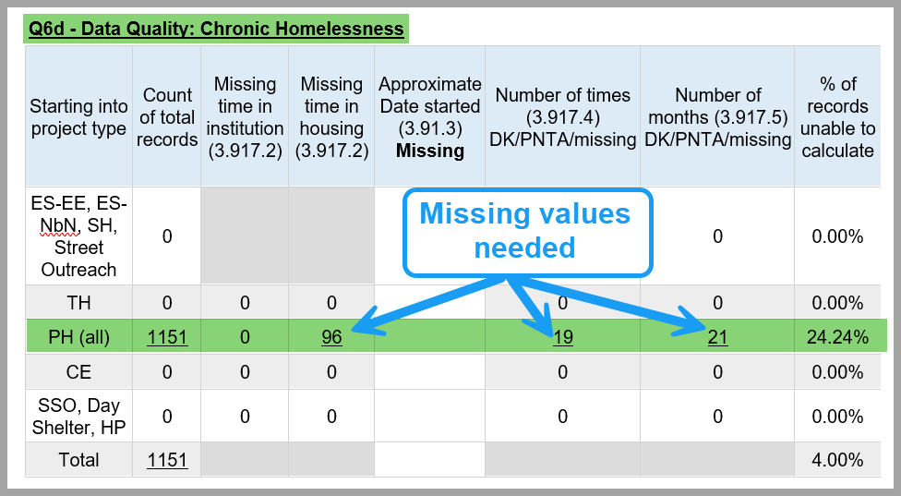
Prior Living Situation - Program Eligibility
Based on the Annual Performance Report (APR)

Slide 16
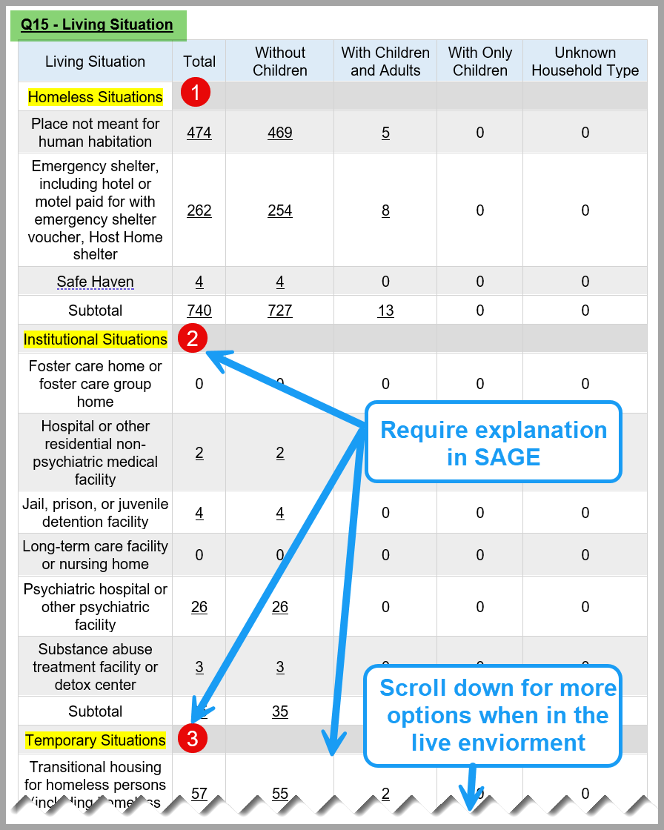
Prior Living Situation - Program Eligibility
Based on the Annual Performance Report (APR)

Slide 17
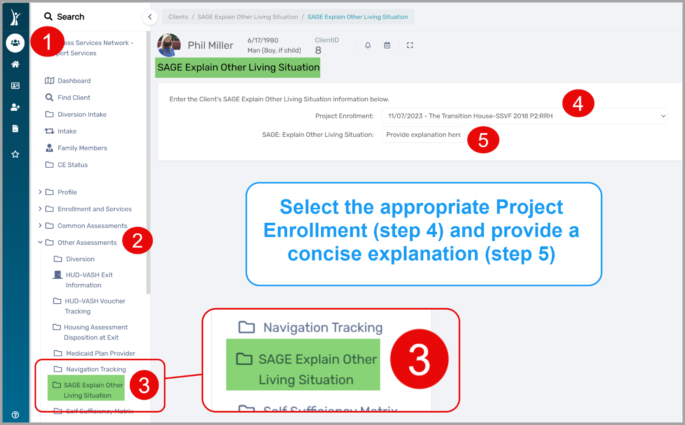
Prior Living Situation - Program Eligibility
Based on SAGE Explain Other LIving Situaion

Slide 18
Housing Move-In Date (HMID)
Only applies to Permanent Housing (PH) projects: Rapid Re-Housing (RRH) & Permanent Support Housing (PSH) and Other PH (OPH).
Only applies to the participant identified as the Relationship to Head of Household = “Self”
The HMID must be greater than or after the Enrollment Start and less than or before the Exit Date.
The HMID is NOT the lease date but rather the actual date the participant moves into their housing.

Slide 19
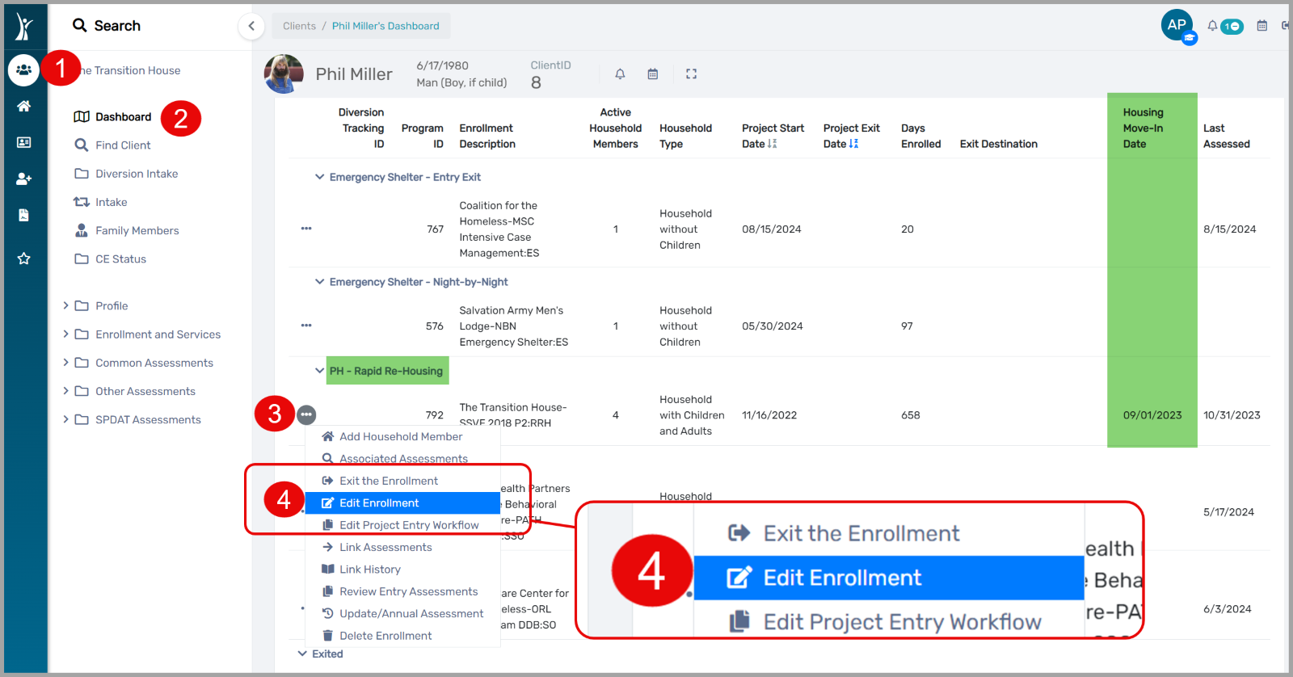
Housing Move-In Date (HMID)
Getting to "Edit Enrollment" from the Client Dashboard.

Slide 20
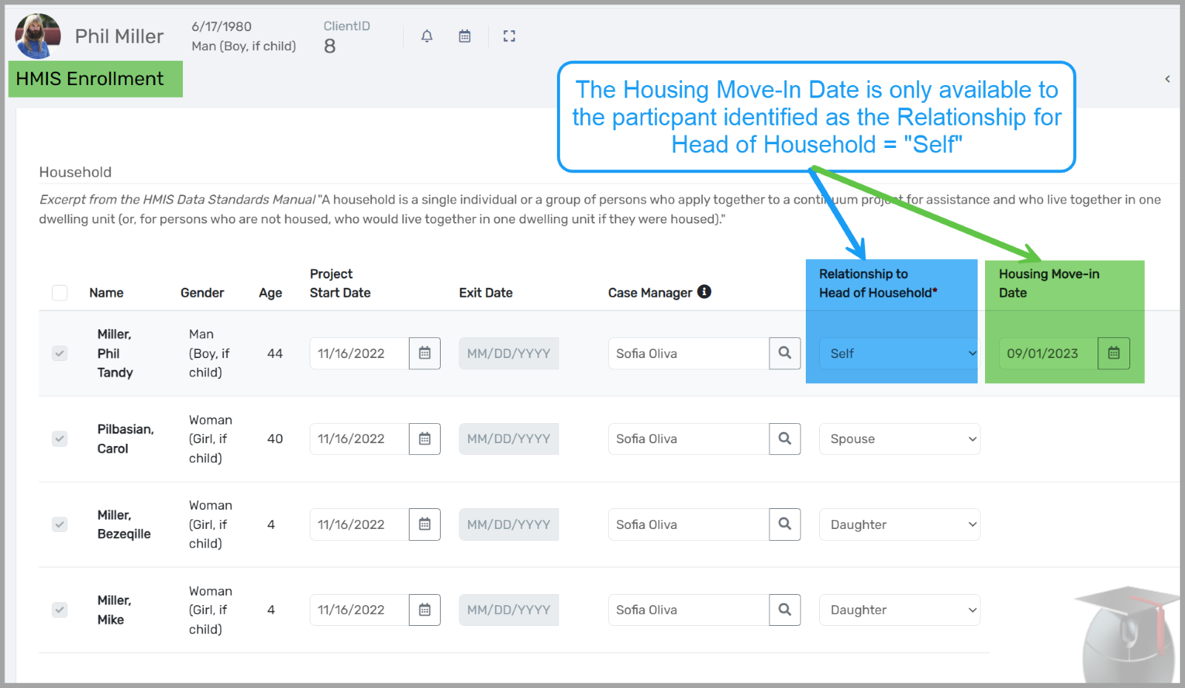
Housing Move-In Date (HMID)
Based on using Edit Enrollment

Slide 21
Review Enrollment Dashboard

Slide 22
Review Enrollment Dashboard
Let's do a walkthrough!

Slide 23
Christian Service Awards Breakfast Gala – Oct 11th
Christian Service Awards & Annual Breakfast
Friday, Oct 11th 7:30am –10am
Location: Faith Hall at First Baptist Orlando
This annual banquet is the primary fundraising event for the Christian Service Center. The purpose of the Christian Service Awards is to bring recognition such that the selfless work of others may inspire others to similar action. We believe that together, we can build a stronger, more compassionate community.
Learn more about the event here!

Slide 24
Training Registration Feedback

Slide 25
HSN University Training
We are encouraging our trainees to complete the HMIS 101 New User Training
via HSN University vs waiting for a live training session.
HMIS 101 Course Requirements include:
Completion of all required course modules;
Demonstrate knowledge in the practical portion of the training by completing required tasks/workflows in the HMIS training site;
Review, sign and submit the HMIS User Agreement
Other courses available in HSN University include:
HMIS 101 New User HMIS Agency Liaison Orientation
HMIS 101: Refresher HMIS 102: PATH
HMIS 102: Street Outreach HMIS 102: SSVF
Upcoming Virtual Courses: Reporting and Data Quality in ClientTrack
Notes:
Presenter: Racquel
Next Slide: Racquel

Slide 26
HMIS Training & Support
HMIS data collection templates are available on our website at: www.hmiscfl.org
Recommended to have hard copies on hand in the event that inclement weather results in a power outage.
Fillable templates available for all projects types and collection points
entry, exit, update and annual assessment templates
emergency shelter, transitional, rapid-rehousing, PATH, SSVF, ect.
Schedule a Live HMIS Refresher Training!
Agencies are invited to schedule an in-person HMIS Refresher training for your HMIS users. This opportunity is now available year-round!
Schedule your agency for this training at:
Book time with Racquel McGlashen: HMIS Refresher Training (In-person)
Questions? Contact us at hmis@hsncfl.org
Notes:
Presenter: Racquel
Next Slide: Racquel

Slide 27
HMIS Data Quality Monitoring
Our current fiscal year is coming to a close!
Providers are expected to review and clean up data as much as possible for:
October 1, 2023 to September 30, 2024
Data Quality Clean-Up Tips
Run the Clients in Program Report and Annual Performance Report within the first weeks of October.
Review and correct data where possible in APR Data Quality Tables.
Q5a
Q6a - Q6f
Review accuracy of active enrollments.
Close out clients no longer receiving services.
Be sure to add all necessary services prior to exiting clients out of projects.
Reminder: Data cleansing helps prepare our community for reporting to HUD and other federal funders and give us an accurate picture of what is going on in our community/system.
Notes:
Presenter: Racquel
Next Slide: Brad
Next Slide: Ashley
Next Slide: Ashley

Slide 28
Agency Liaison Partner Appreciation Brunch
The HMIS team wants to show our appreciation to the agency liaisons in our community for your awesome commitment to user and project management, and data quality performance!
Join us for our first ever
Agency Liaison Partner
Appreciation Brunch!
WHEN: November 15th, 2024 at 10:30a
WHERE: Homeless Services Network, The Atrium
142 East Jackson Street, Orlando, FL 32801
RSPV: Formal invites will be emailed out soon!

Slide 29
HMIS Training & Support
Our routine monthly training calendar:
1st & 3rd Tuesday: HMIS 101 New User Training (9a - 2p)
2nd & 4th Wednesday: HMIS 101/102 Refreshers (2p - 4p)
3rd Tuesday: ClientTrack Introduction to Reports Training (3p - 4:30p)
Ad-Hoc Reports Training (request via HMIS Support Ticket)
APR/CAPER in ClientTrack
Everyday Reporting in ClientTrack
Explore Data Explorer
Data Quality Workshop
Join us for our office hours M/W from 1p - 2p for additional one-on-one HMIS support.
Reminders:
All new user training requests must come through the Agency Liaison.
Agency Liaison needs to let the HMIS team know ASAP when someone leaves
the agency so we can inactivate accounts. This is to protect the system and keep an accurate count of available subscriptions for assignment.
Notes:
Presenter: Racquel
Next Slide: Racquel
Next Slide: Raquel

Slide 30
Reminder: Release of Information Policy
Partner Agencies participating in HMIS must post the HMIS Privacy Notice in visible locations.
This notice informs clients that their personal information will be shared electronically with other Partner Agencies using HMIS to facilitate appropriate client services.
By continuing to engage with services, clients are considered to have provided implied consent for the sharing of their data among all Partner Agencies, unless they explicitly opt-out.
Once a Partner Agency has recorded a client's implied consent, additional consent collection is not required unless the client explicitly revokes consent.
If a client chooses not to allow their data to be shared:
Their record must be marked as RESTRICTED, limiting access to the agency that originally entered the data.
The client's decision regarding data sharing is recorded in the "Information Release and Security" section of the HMIS software and is visible on the client dashboard.
Review Full HMIS Policies and Procedures Here
Notes:
Presenter: Racquel
Next Slide: Brad
Next Slide: Ashley
Next Slide: Ashley

Slide 31
Committee Roll-Call Vote
HMIS Committee Officers
Notes:
Presenter: Brad
Next Slide: Brad

Slide 32
Committee Roll-Call Vote
Any other motion before committee
Notes:
Presenter: Brad -Open to motions by committee members
Next Slide: Brad

Slide 33
Thank you for attending!
Next meeting date:
Tuesday, November 12th, 2024
10:30 am to 12:00 pm
HMIS Guides, Documents, Training, Acronyms & More
hmiscfl.org
https://www.hmiscfl.org/training/datadefinitions/
Notes:
Brad Closes Meeting

Slide 34
HSN HMIS Team
Brittney Behr
HMIS Project Coordinator
Racquel McGlashen
HMIS Partner Success Specialist
Tim Reed
HMIS Partner Success Specialist
Angel Jones
HMIS Operations Manager
Agustin “Tino” Paz
HMIS Senior Data Analyst
Ashley Brozenske
HMIS Data Analyst I

